Slide 1

Unit 2

Slide 2
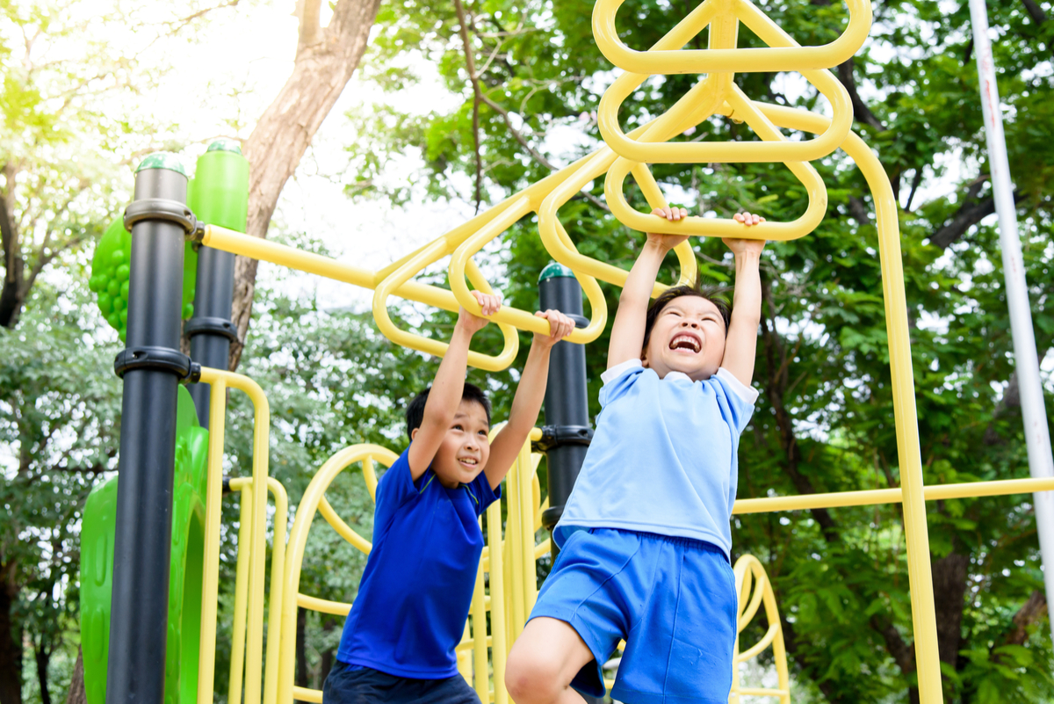
Unit 2
How often do you exercise?

Slide 3
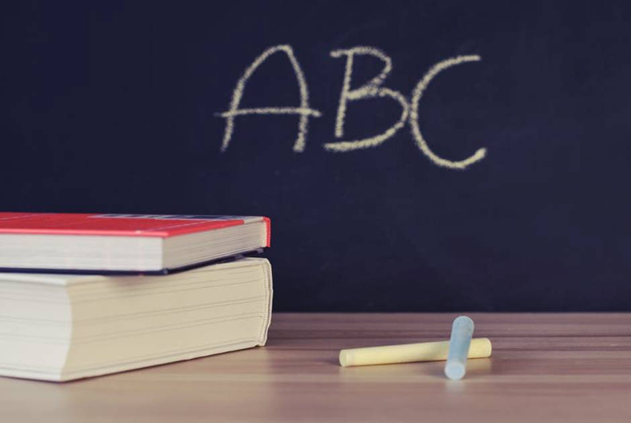
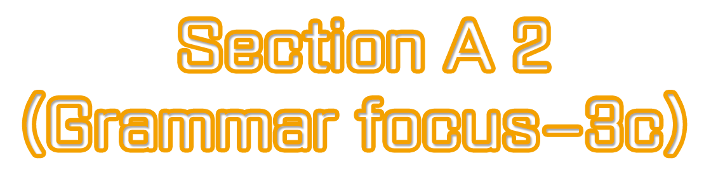

Slide 4


Complete the questions with do or does. Then match the questions and answers.
1. How often _____ he play soccer?
2. _____ you drink milk?
3. How often _____ they stay up late?
4. _____ Sue eat a healthy breakfast?
5. How often _____ you eat apples?
6. _____ your parents play sports?
does
Do
do
Does
do
Do
Note: 主语为第三人称单数时，助动词用does；
主语为其他人称及第三人称复数时,用do。

Slide 5
a. Yes. She usually does.
b. Hardly ever. I don’t like them.
c. He plays at least twice a week.
d. No, they don’t. They’re too busy.
e. Never. They always go to bed early.
f. Yes, I do. Every day.
至少
1. How often does he play soccer?
2. Do you drink milk?
3. How often do they stay up late?
4. Does Sue eat a healthy breakfast?
5. How often do you eat apples?
6. Do your parents play sports?
c
f
e
a
b
d

Slide 6


Use the words given to write questions. Then ask and answer them with a partner.
Questions:
__________________________________?
(how often / help with housework)
2. __________________________________?
(what / usually / do / weekends)
How often do you help with housework
What do you usually do on weekends

Slide 7
3. ___________________________________?
(how often / best friend / exercise)
4. ___________________________________?
(what / usually / do / after school )
How often does your best friend exercise
What do you usually do after school

Slide 8


1. To learn to use “How often …?” and answer the questions with some adverbs of frequency: always/ usually/ often/ sometimes/hardly ever /never/ twice …
2. To learn to use:
What do you usually do on weekends?

Slide 9


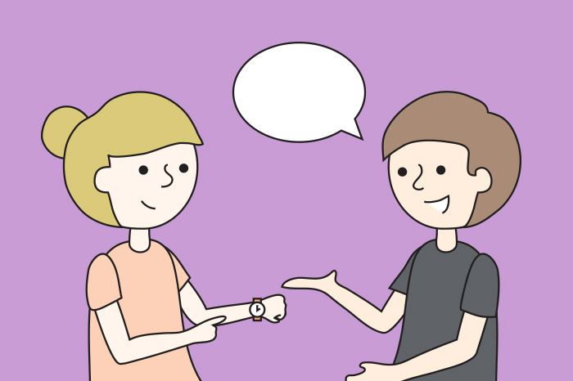
Role-play the conversation in 2d.
Hi, Claire, are you free next week?
Hmm, ...

Slide 10



频度副词
always | 总是 | 表示动作的重复或状态的延续
usually | 通常 | 表示很少有例外
often | 经常 | 表示动作的重复，但不如 usually频繁，中间有间断
sometimes | 有时 | 表示动作偶尔发生
hardly ever | 几乎从不
never | 从未

Slide 11
100%
≥ 80%
≥ 60%
always
usually
often
≥ 20%
＜ 5%
0%
sometimes
hardly ever
never
提示：频率副词在句中的位置通常是：
实义动词之前，be动词、助动词或情态动词之后。

Slide 12
e.g. It is always interesting to watch other people show their talents.
Why do people usually make resolutions(决心)?
When we watch movies about the future, we sometimes see robots.
They hardly ever watch TV.
Fewer people will do such jobs in the future because they are boring, but robots will never get bored.

Slide 13
What do you usually do on weekends? | I always exercise.
What do they do on weekends? | They often help with housework.
What does she do on weekends? | She sometimes goes shopping.
What … do on weekends? 询问课余活动
1）答语可用频度副词表示活动的频率；
2）频度副词一般在主语后、实义动词之前。

Slide 14

How often do you go to the movies? | I go to the movies maybe once a month.
How often does he watch TV? | He hardly ever watches TV.
对频率提问
how often 多久一次
用于提问频率的特殊疑问词组。
其答语应为表示频率的副词或副词词组。
句子的时态一般是一般现在时态，也可以是一般过去时。

Slide 15

1. Bill never goes to the cinema. (对划线部分提问)
How often does Bill go to the cinema?
2. I wash my clothes three times a week. (对划线部分提问)
How often do you wash your clothes?
3. Peter goes home once a week. (对划线部分提问)
_______ _______ _______ Peter _______ home?
4. Eric takes a shower every day. (对划线部分提问)
_______ _______ _______ Eric _______ a shower?
How often does go
How often does take

Slide 16
根据语境及括号内所给英文提示语，用完整的句子补全下
列对话。
1. A: Do they walk to school?
B: Yes. _________________________________. (every day)
2. A: How often do you have breakfast at home, Jim?
B: _____________________________________________
______________________________. (usually)
They walk to school every day
I usually have breakfast at home / Usually I have breakfast at home

Slide 17
3. A: How often does Mr. Steen play sports?
B: _____________________________________. (four times a week)
4. A: How often does Bert stay up late?
B: __________________________________________________
__________________________________. (sometimes)
5. A: Does Julia go to music classes?
B: No. __________________________________. (never)
He plays sports four times a week
He sometimes stays up late / Sometimes he stays up late / He stays up late sometimes
She never goes to music classes

Slide 18

1. When you go abroad, _______ forget to bring your passport. (2021辽宁盘锦中考)
A. always B. hardly C. never D. sometimes
C
2. You and I are lucky as we’ve ________ had to worry about finding clean water. (2021山东临沂中考)
A. often B. usually C. never
C

Slide 19
3. Please be polite and ________ offer your seat to people who need it. (2021河北)
A. never B. seldom C. sometimes D. always
D
4. 完成句子 （2021湖北襄阳中考）
她每天总是在晚饭后完成她的家庭作业。（finish）
She ______________________________after dinner every day.
always finishes her homework

Slide 20
5. 按要求完成下面各句。每空一词。(2021四川达州中考)
The woman hardly eats meat because of losing weight.（对划线部分提问）
____________ does the woman eat meat because of losing weight?
How often

Slide 21

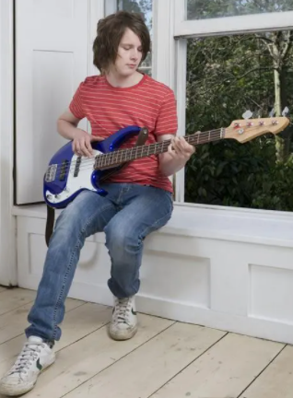
比一比，看谁说得又快又好？
What do you do on weekends?
100%
≥ 80%
≥ 20%
I always play the guitar on weekends.
I usually play the guitar on weekends.
I sometimes play the guitar on weekends.

Slide 22
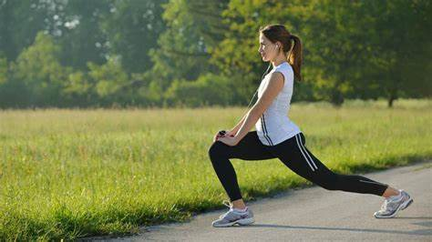
What do you do on weekends?
≥ 20%
＜ 5%
0%
I sometimes exercise on weekends.
I hardly ever exercise on weekends.
I never exercise on weekends.

Slide 23

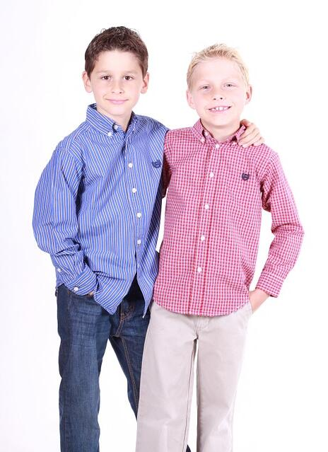
How often do you help with housework?
I…
What do you usually do on weekends?
I …

Slide 24
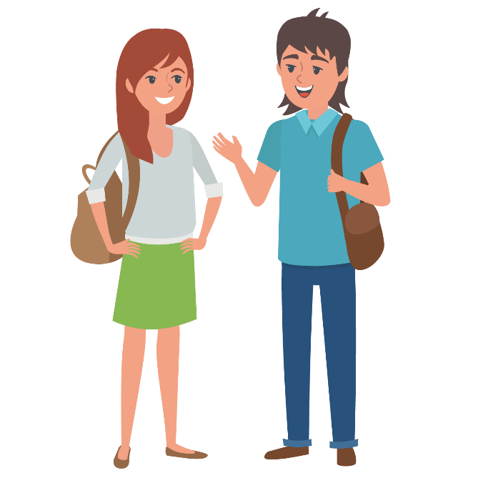
How often does Alice exercise?
She ...
What does your cousin do after school?
He ...

Slide 25


What can you do to improve your English? Add more things to the chart. Then ask your classmates the questions and find the best English student.

Slide 26

How often do you… | Names | Frequency
read English books? | Lin Ying | twice a week
A: How often do you read English books?
B: I read English books about twice a week.

Slide 27
How often do you… | Names | Frequency
read English books? | Lin Ying | twice a week
go to English club
Hu Tao
twice a week
watch English movies
Su Lei
once a week
write to a pen pal
Ma Li
twice a month
keep an English diary
Hu Tao
every day

Slide 28


Lin Ying reads English books twice a week.
Hu Tao goes to English Club twice a week.
Su Lei watches English movies once a week.
Ma Li writes to a pen pal twice a month.
Hu Tao keeps an English diary every day.
I think Hu Tao is the best English student.

Slide 29


1. I go to the movies maybe once a month.
我可能一个月去看一次电影。
maybe adv. 大概；或许；可能
可与“may+动词原形”相互转换
e.g. Maybe you are right. = You may be right.
Maybe Mary will stay at home this afternoon.
= Mary may stay at home this afternoon.

Slide 30

maybe & may be
maybe adv. | “可能；也许”，可用于句首或句中作状语。
may be | 由情态动词may加系动词be构成的，意为“可能是；也许是”，与主语及后面所接的名词、形容词、介词短语等构成“主系表结构”。

Slide 31
【语境应用】I. 选词填空。
1) —I can't find my watch.
—_________(Maybe / May be) you left it in the classroom.
2) The traffic (交通) is so bad. I _________ (maybe / may be) late today.
3) John visits his uncle _______(maybe / may be) once a month.
Maybe
may be
maybe

Slide 32
II. 改为同义句。
1) He may go to work tomorrow.
2) Maybe Sara is in the classroom now.
Maybe he will go to work tomorrow.
Sara may be in the classroom now.

Slide 33
2. He plays at least twice a week.
他每周最少踢两次。
at least 至少; 不少于；起码
副词词组，指在数量或程度上。
e.g. 你必须至少一周打扫一次你的房间。
You have to clean your house ____________________.
at least once a week

Slide 34


–How often do you / they…?
–I always / usually / sometimes / never…
–How often does he/she…
–He / She often / hardly ever…
–He / She …once / twice / three times a month…

Slide 35


Ⅰ. 根据语境及括号内所给英文提示语，用完整的句子补全下列对话。
1. A: Does Mike drink milk?
B: Yes. _______________________. (every day)
2. A: Do you eat hamburgers?
B: No. _______________________. (never)
He drinks milk every day
I never eat hamburgers

Slide 36
3. A: How often does Peter go to the library?
B: _____________________________________. (three times a week)
4. A: How often do they take the bus to school?
B: _________________________________________________
_________________________________________________.
________________. (sometimes)
5. A: How often does Mrs. Black see her friends after work?
B: __________________________________________________
________________________________. (usually)
He goes to the library three times a week
Sometimes they take the bus to school / They sometimes take the bus to school / They take the bus to school sometimes
She usually sees her friends after work / Usually she sees her friends after work

Slide 37
Ⅱ. 根据短文内容及方框中所给提示，补全所缺内容，使短文完整、通顺。
Things Vicky and her friend Julia do
Vicky and Julia → go to sleep → hardly ever Julia → sleep at Vicky’s house → sometimes Julia → call Vicky → usually Vicky and Julia → go to school together → always Julia → visit her grandparents → often Julia → play computer games → never
I’m Vicky. My best friend is Julia. We do lots of things together. We’re in the same class and (1)_________________________________ by bus.
we always go to school together

Slide 38
Things Vicky and her friend Julia do
Vicky and Julia → go to sleep → hardly ever Julia → sleep at Vicky’s house → sometimes Julia → call Vicky → usually Vicky and Julia → go to school together → always Julia → visit her grandparents → often Julia → play computer games → never
When we are not together, I sometimes send (发送) her text messages. And (2)________________________________________ before I go to bed. (3)_________________________ without (没有) saying good night to each other.
Julia usually calls me / usually Julia calls me
We hardly ever go to sleep

Slide 39
Things Vicky and her friend Julia do
Vicky and Julia → go to sleep → hardly ever Julia → sleep at Vicky’s house → sometimes Julia → call Vicky → usually Vicky and Julia → go to school together → always Julia → visit her grandparents → often Julia → play computer games → never
However, we have some differences. (4)_______________________________ but I love playing them. I love pop music but she dislikes it. Julia likes drinking coffee but I like tea.
On weekends, Julia and I often meet with our school friends.
Julia never plays computer games

Slide 40
Things Vicky and her friend Julia do
Vicky and Julia → go to sleep → hardly ever Julia → sleep at Vicky’s house → sometimes Julia → call Vicky → usually Vicky and Julia → go to school together → always Julia → visit her grandparents → often Julia → play computer games → never
Julia sometimes sleeps at my house / Sometimes Julia sleeps at my house / Julia sleeps at my house sometimes
(5)_______________________________________________________________________________________________ on Friday nights and sometimes I’m at her house on Saturday nights to do my homework. On Sundays, we’re not together because (6)_________________________________.
Julia often visits her grandparents

Slide 41
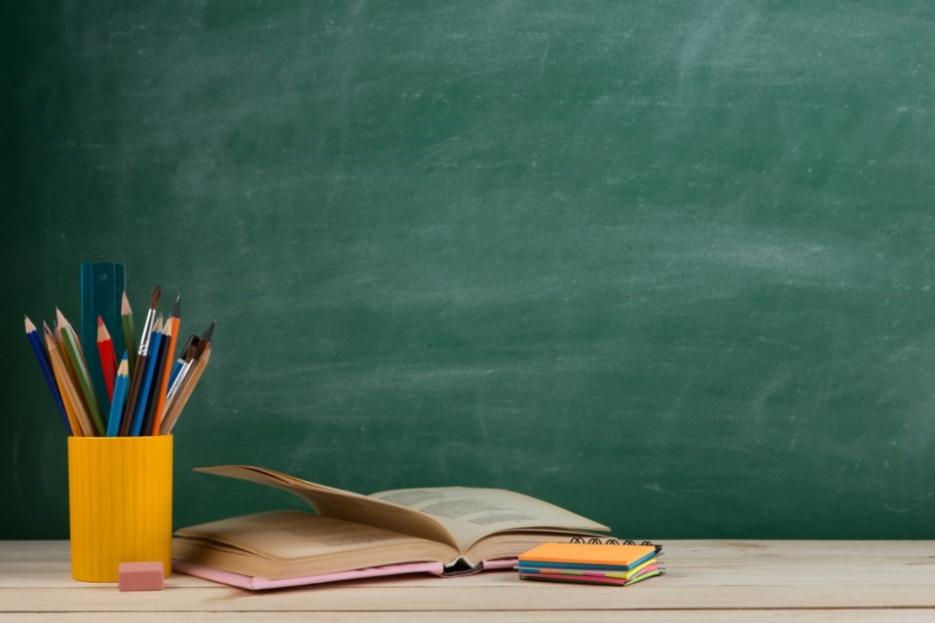

Do a survey:
What does your best friend do on weekends?
Name | Activity | How often
Bob | play computer games | usually
Report:
Bob usually plays computer games.
He hardly ever watches TV…

Slide 42

What other ways can we do to improve English? Watch a video and take notes.
1 | One of your interests (read and talk)
2
3
4 | __________
5 | __________
6 | __________
___ stress（压力）
No
_____ content（情境）
Good
Watch a lot
Listen a lot
Talk a lot

Slide 43

What other ways can you think of?
listen to English news
read English books
join an English club
chat with English-speaking people
try to think in English
use English as much as possible
…

Slide 44


